Slide 1


Master Thesis: Choice set Size effect on contracting in Supply chain
Author: Diego Arinze Uchendu
221616
Supervisor: Prof. Dr. Sven Müller
Chair of Operations Management
Master Degree in Operations Research and Business Analytics

Slide 2
OUTLINE
Introduction
WorkFlow
Supply Chain (Data)
Modeling
Results
Demo
Conclusion

Slide 3
INTRODUCTION
How choice set cardinality as an attribute effect contract alternatives.
Reduce Choice Overload.
Aim to Maximize the Expected Profit of the supplier while ensuring that a buyer selects a contract among contract alternatives.

Slide 4
WORK FLOW
Data
Convert from MATLAB to R
Modelling
Write Algebraic Model, both MINLP and MILP.
Result
Extract from Excel File.
Automate ´to accept other different values.
Write to Excel
Translate to GAMS and Write Results to Excel
Performed Visualization.
Used Shiny to Make sense of results.

Slide 5
SUPPLY CHAIN(DATA)
Buyer Types
Capacity Reservation Contract
Supply Chain between seller and buyer
Contract Menu (Unique Contracts)

Slide 6

BUYER TYPES
Supplier has 2 types of buyers
Low type buyer: demand $d$ is less or equal to the Average market demand $μ=2$.
High type buyer: $d>μ$.
Buyer has no Incentive to reveal her private forecast information $ξ$.
Supplier considers $ξ$ zero mean U~[-1,1].
Supplier knows her prior probability distribution $p\left(ξ\right)=0.5$.
Demand uncertainty $ε$, lying in interval U~[-1,1].

Slide 7
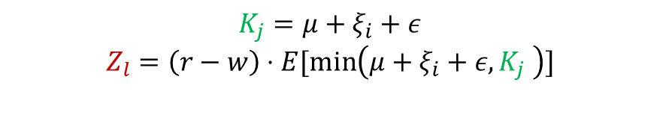
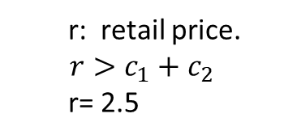
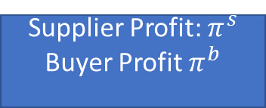
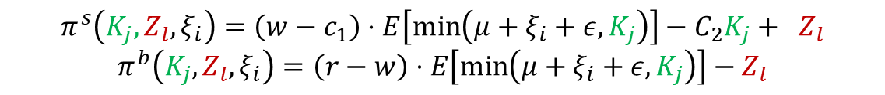
SUPPLY CHAIN BETWEEN A BUYER AND SELLER
C1: unit cost of 5nm chip.
C2: capacity installation cost
C1=0, C2= 0.5
W: Wholesale price per unit
w= 1
r: retail price.
$$r>c_{1}+c_{2}$$
r= 2.5
Supplier
(TSMC)
Order
Buyer
(Apple Inc)
Demand Uncertainty
Delivery
Capacity level
$$K_{j}=μ+ξ_{i}+ε$$
$$Z_{l}=\left(r−w\right)⋅E[\min\left(μ+ξ_{i}+ε,K_{j} \right)]$$
Reserve Fees
$$π^{s}\left(K_{j},Z_{l},ξ_{i}\right)=\left(w−c_{1}\right)⋅E\left[\min\left(μ+ξ_{i}+ε,K_{j}\right)\right]−C_{2}K_{j}+ Z_{l}$$
$$π^{b}\left(K_{j},Z_{l},ξ_{i}\right)=\left(r−w\right)⋅E\left[\min\left(μ+ξ_{i}+ε,K_{j}\right)\right]−Z_{l}$$
Supplier Profit: $π^{s}$
Buyer Profit $π^{b}$

Slide 8
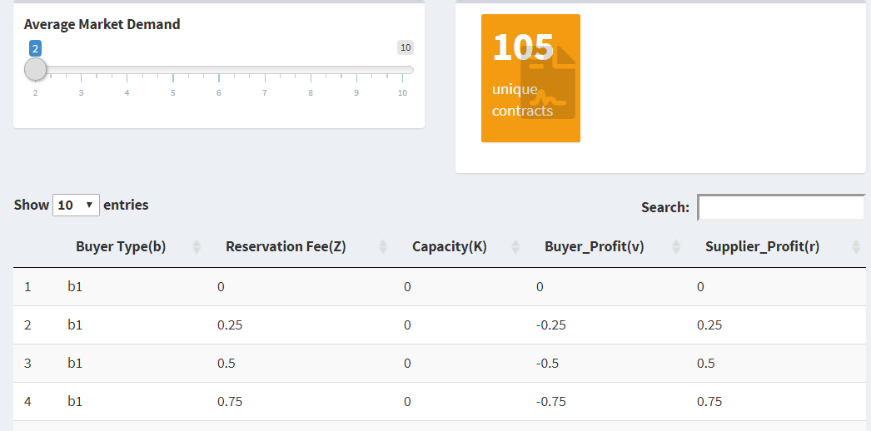
Contract Menu
Taiwan Semiconductor manufacturing company (TSMC) prepares list of unique contracts.

Slide 9

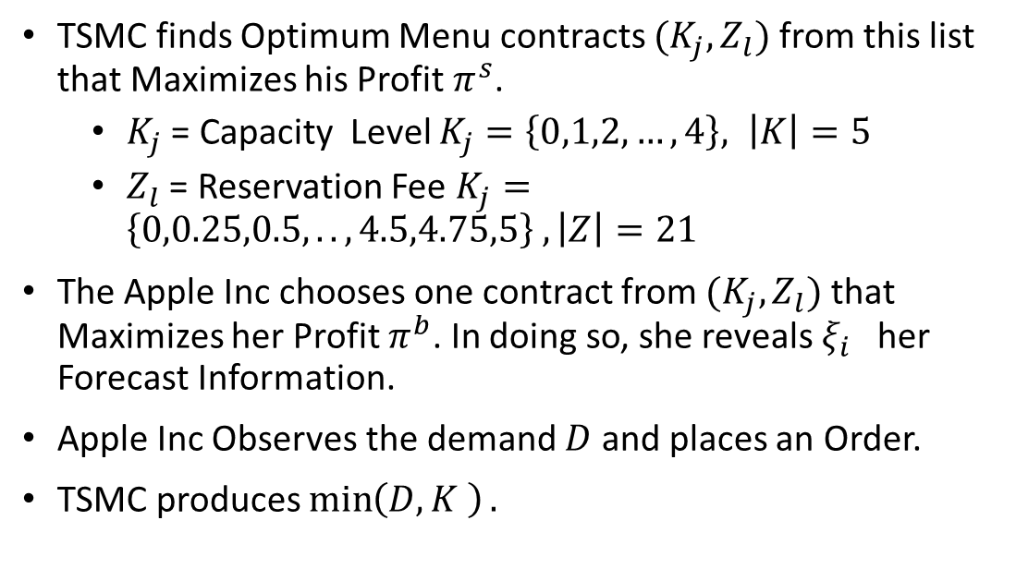
CAPACITY RESERVATION CONTRACT
TSMC finds Optimum Menu contracts $(K_{j},Z_{l})$ from this list that Maximizes his Profit $π^{s}$.
$K_{j}$ = Capacity Level $K_{j}=\left\{0,1,2,…,4\right\}, \left|K\right|=5$
$Z_{l}$ = Reservation Fee $K_{j}=\left\{0,0.25,0.5,..,4.5,4.75,5\right\} , \left|Z\right|=21$
The Apple Inc chooses one contract from $(K_{j},Z_{l})$ that Maximizes her Profit $π^{b}$. In doing so, she reveals $ξ_{i}$ her Forecast Information.
Apple Inc Observes the demand $D$ and places an Order.
TSMC produces $\min\left(D,K \right).$

Slide 10
MODELING
Previous Work
$$v_{i,j,l}=β_{π^{b}}⋅π^{b}\left(K_{j},Z_{l},ξ_{i}\right)$$
Profit
Previous Work
𝑣_(𝑖,𝑗,𝑙)=𝛽_(𝜋^𝑏 )⋅𝜋^𝑏 (𝐾_𝑗,𝑍_𝑙,𝜉_𝑖 )
Profit
MINLP
MILP
$$v_{i,j,l}=β_{π^{b}}⋅π^{b}\left(K_{j},Z_{l},ξ_{i}\right)−β_{m}M$$
Buyers’ Utility Function
𝑣_(𝑖,𝑗,𝑙)=𝛽_(𝜋^𝑏 )⋅𝜋^𝑏 (𝐾_𝑗,𝑍_𝑙,𝜉_𝑖 )−𝛽_𝑚 𝑀
Buyers’ Utility Function

Slide 11

PREVIOUS WORK
This Thesis is an extension of A Choice Based Optimization Approach for Contracting in Supply Chains by Römer et al (2020).
In Choosing a contract, Only the buyer’s profit was considered.
Opt-out utility $\overline{v_{i}}=0$
Utility of choosing contract $v_{i,j,l}=β_{π^{b}}⋅π^{b}\left(K_{j},Z_{l},ξ_{i}\right)$
Profit Estimate
Buyers’ Profit

Slide 12
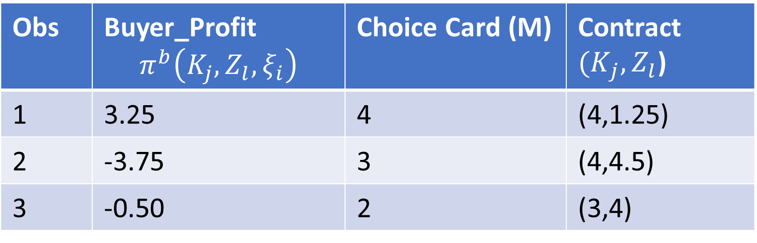

BUYERS’S UTILITY FUNCTION
Choice set Estimate
Choice Set Cardinality
Opt-out utility $\overline{v_{i}}=0$
Utility of choosing contract $v_{i,j,l}=β_{π^{b}}⋅π^{b}\left(K_{j},Z_{l},ξ_{i}\right)−β_{m}M$
Obs | Buyer_Profit $$π^{b}\left(K_{j},Z_{l},ξ_{i}\right)$$ | Choice Card (M) | Contract ${(K}_{j},Z_{l}$)
1 | 3.25 | 4 | (4,1.25)
2 | -3.75 | 3 | (4,4.5)
3 | -0.50 | 2 | (3,4)

Slide 13
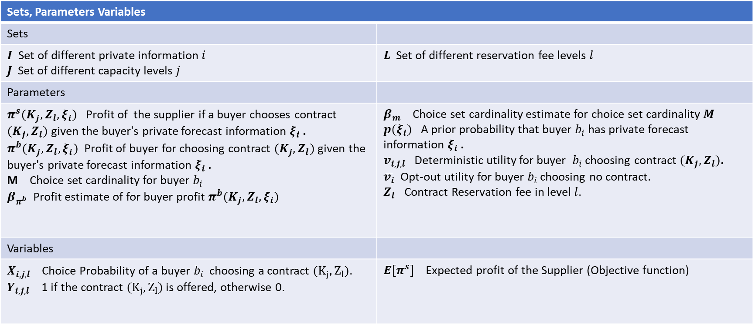
MINLP
Sets, Parameters Variables
Sets
$I$ Set of different private information $i$ $J$ Set of different capacity levels $j$ | $L$ Set of different reservation fee levels $l$
Parameters
$π^{s}(K_{j},Z_{l},ξ_{i})$ Profit of the supplier if a buyer chooses contract $(K_{j},Z_{l})$ given the buyer's private forecast information $ξ_{i}$ . $π^{b}(K_{j},Z_{l},ξ_{i})$ Profit of buyer for choosing contract $(K_{j},Z_{l})$ given the buyer's private forecast information $ξ_{i}$ . M Choice set cardinality for buyer $b_{i}$ $β_{π^{b}}$ Profit estimate of for buyer profit $π^{b}(K_{j},Z_{l},ξ_{i})$ | $β_{m}$ Choice set cardinality estimate for choice set cardinality $M$ $p(ξ_{i})$ A prior probability that buyer $b_{i}$has private forecast information $ξ_{i}$ . $v_{i,j,l}$ Deterministic utility for buyer $b_{i}$ choosing contract $(K_{j},Z_{l})$. $\overline{v_{i}}$ Opt-out utility for buyer $b_{i}$ choosing no contract. $Z_{l}$ Contract Reservation fee in level $l$.
Variables
$X_{i,j,l}$ Choice Probability of a buyer $b_{i}$ choosing a contract $(K_{j},Z_{l})$. $Y_{i,j,l}$ 1 if the contract $(K_{j},Z_{l})$ is offered, otherwise 0. | $E[π^{s}]$ Expected profit of the Supplier (Objective function)

Slide 14
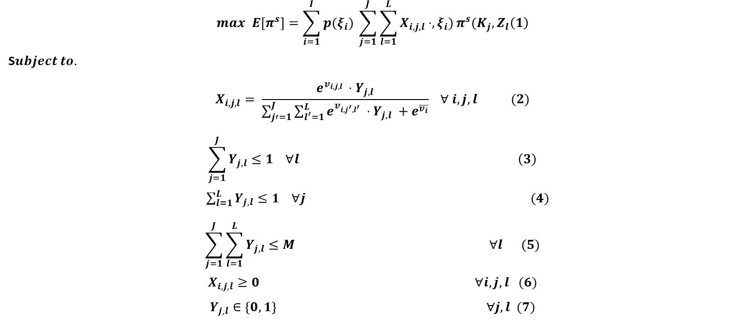
MINLP
(1). Maximize Supplier‘s expected Profit.
(2) Buyer‘s Choice Probability.
(3) Select a contract from capacity levels.
(4) Select a contract from Reservation fee levels.
(5) Choice set Size constraint.
(6) And (7) domain contraints
$$max E\left[π^{s}\right]=\sum_{i=1}^{I}{p(ξ_{i})} \sum_{j=1}^{J}{\sum_{l=1}^{L}{X_{i,j,l}⋅,ξ_{i})}}π^{s}(K_{j},Z_{l}\left(1\right)$$
S$ubject to.$
$$X_{i,j,l}= \frac{e^{v_{i,j,l }}⋅Y_{j,l}}{\sum_{j′=1}^{J}{\sum_{l^{′}=1}^{L}{e^{v_{i,j^{′},l^{′} }}⋅Y_{j,l}}} +e^{\overline{v_{i}}}} ∀ i,j,l (2)$$
$$\sum_{j=1}^{J}{Y_{j,l}}≤1 ∀l \left(3\right)$$
$\sum_{l=1}^{L}{Y_{j,l}}≤1 ∀j (4)$
$$\sum_{j=1}^{J}{\sum_{l=1}^{L}{Y_{j,l}}}≤M ∀l (5)$$
$$X_{i,j,l}≥0 ∀i,j,l (6)$$
$$Y_{j,l}∈\left\{0,1\right\} ∀j,l (7)$$

Slide 15

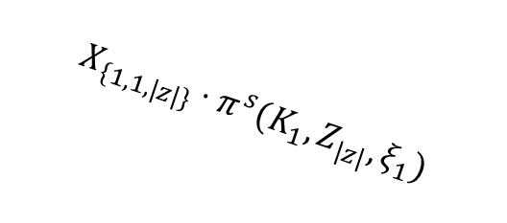











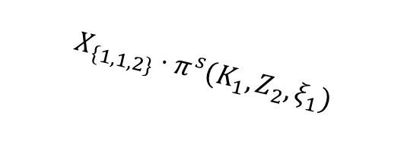
MINLP (Objective Function)
max $E\left[π^{s}\right]= ∑_{_\left\{i=1\right\} }^{I}$ $p_{(ξ_{i})}$ $∑_{_\left\{j=1\right\} }^{J}$ $∑_{_\left\{l=1\right\} }^{l}$ $X_{\left\{i,j,l\right\}}⋅π^{s}(K_{j}, Z_{l}, ξ_{i})$
$$I=\{1,2\}$$
$$p_{(ξ_{1})}$$
$$j1$$
$$X_{\left\{1,1,1\right\}}⋅π^{s}(K_{1}, Z_{1}, ξ_{1})$$
$$l1$$
Equation (1)
$$i1$$
$$X_{\left\{1,1,2\right\}}⋅π^{s}(K_{1}, Z_{2}, ξ_{1})$$
$$j2$$
$$l2$$
$$X_{\left\{1,1,|z|\right\}}⋅π^{s}(K_{1}, Z_{|z|}, ξ_{1})$$
$$p_{(ξ_{2})}$$
…
…
$$i2$$
$$|K|$$
$$|Z|$$

Slide 16
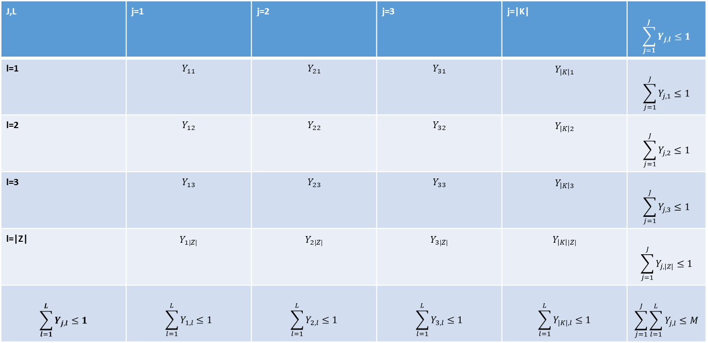
MINLP (OFFERED CONTRACT)
J,L | j=1 | j=2 | j=3 | j=|K| | $$\sum_{j=1}^{J}{Y_{j,l}}≤1$$
l=1 | $$Y_{11}$$ | $$Y_{21}$$ | $$Y_{31}$$ | $$Y_{\left|K\right|1}$$ | $$\sum_{j=1}^{J}{Y_{j,1}}≤1$$
l=2 | $$Y_{12}$$ | $$Y_{22}$$ | $$Y_{32}$$ | $$Y_{\left|K\right|2}$$ | $$\sum_{j=1}^{J}{Y_{j,2}}≤1$$
l=3 | $$Y_{13}$$ | $$Y_{23}$$ | $$Y_{33}$$ | $$Y_{\left|K\right|3}$$ | $$\sum_{j=1}^{J}{Y_{j,3}}≤1$$
l=|Z| | $$Y_{1|Z|}$$ | $$Y_{2|Z|}$$ | $$Y_{3|Z|}$$ | $$Y_{\left|K\right||Z|}$$ | $$\sum_{j=1}^{J}{Y_{j,|Z|}}≤1$$
$$\sum_{l=1}^{L}{Y_{j,l}}≤1$$ | $$\sum_{l=1}^{L}{Y_{1,l}}≤1$$ | $$\sum_{l=1}^{L}{Y_{2,l}}≤1$$ | $$\sum_{l=1}^{L}{Y_{3,l}}≤1$$ | $$\sum_{l=1}^{L}{Y_{|K|,l}}≤1$$ | $$\sum_{j=1}^{J}{\sum_{l=1}^{L}{Y_{j,l}}≤M}$$
Euations (3),(4) and (5)
(3) Select a contract from capacity levels.
(4) Select a contract from Reservation fee levels.
(5) Choice set Size constraint.

Slide 17
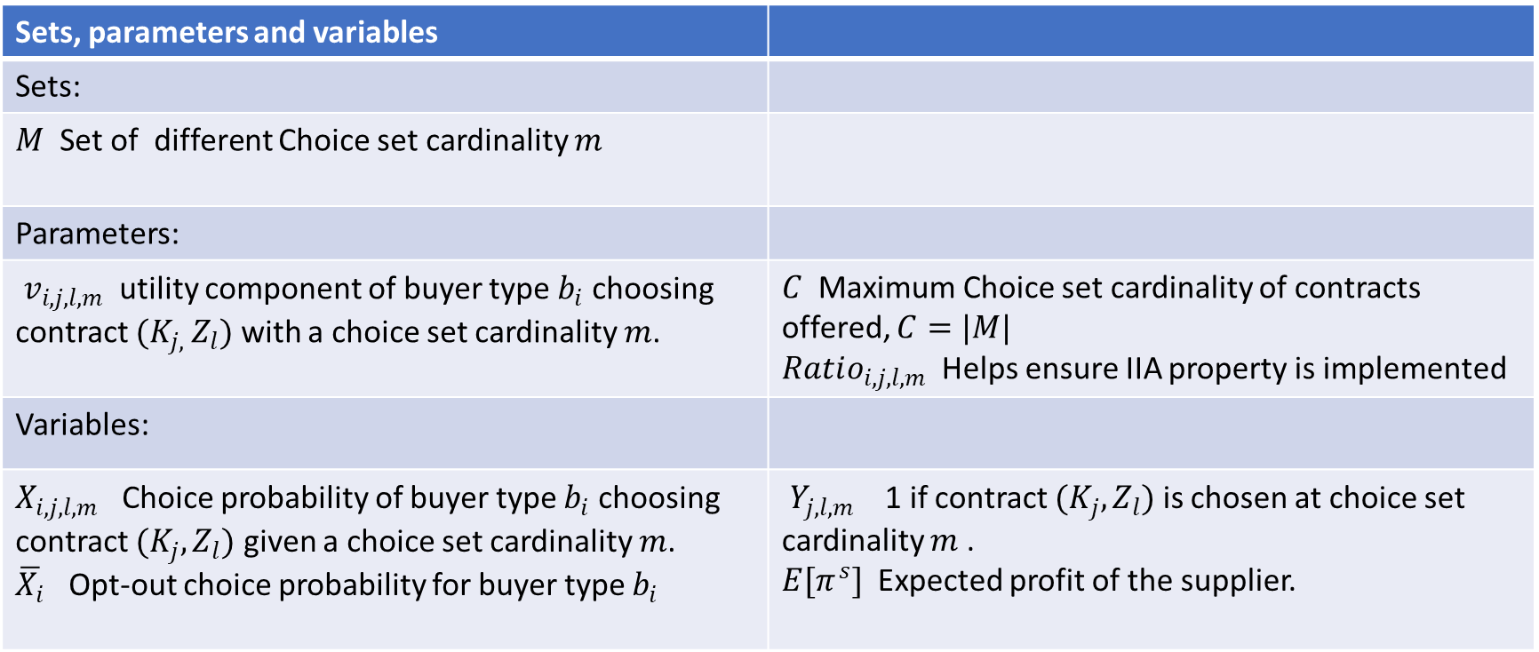
MILP
Sets, parameters and variables
Sets:
$M$ Set of different Choice set cardinality $m$
Parameters:
$v_{i,j,l,m}$ utility component of buyer type $b_{i}$ choosing contract ${(K}_{j, }Z_{l})$ with a choice set cardinality $m$. | $C$ Maximum Choice set cardinality of contracts offered, $C=|M|$ $Ratio_{i,j,l,m}$ Helps ensure IIA property is implemented
Variables:
$X_{i,j,l,m}$ Choice probability of buyer type $b_{i}$ choosing contract ${(K}_{j},Z_{l})$ given a choice set cardinality $m$. $\overline{X_{i}}$ Opt-out choice probability for buyer type $b_{i}$ | $Y_{j,l,m}$ 1 if contract ${(K}_{j},Z_{l})$ is chosen at choice set cardinality $m$ . $E[π^{s}]$ Expected profit of the supplier.

Slide 18
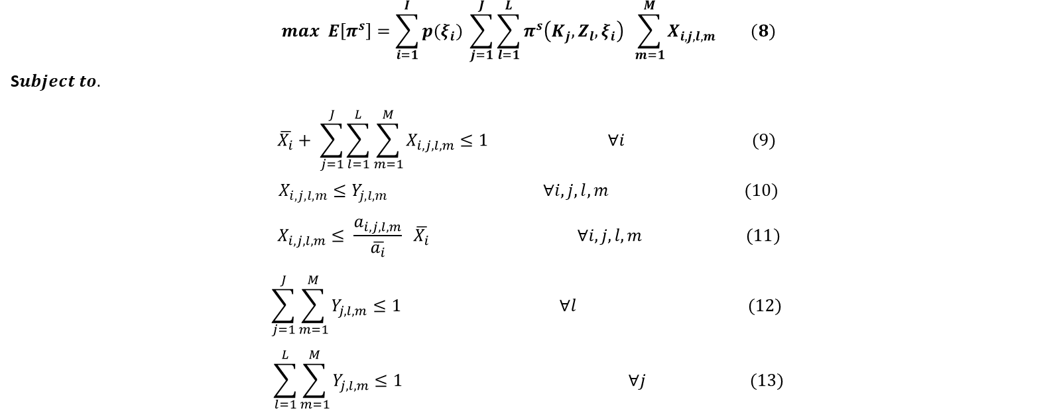
MILP
(8). Maximize Supplier‘s expected Profit.
(9) Sum of Probabilities contraint
(10) Choice prob, less or equ selected contract.
(11) Ratio between choice and opt-out probs is obeyed.
(12)(13) Ensures a contract is established in one cardinality or not at all.
$$max E\left[π^{s}\right]=\sum_{i=1}^{I}{p(ξ_{i})} \sum_{j=1}^{J}{\sum_{l=1}^{L}{π^{s}\left(K_{j},Z_{l},ξ_{i}\right) }}\sum_{m=1}^{M}{X_{i,j,l,m}} (8)$$
S$ubject to.$
$$\overline{X_{i}}+ \sum_{j=1}^{J}{\sum_{l=1}^{L}{\sum_{m=1}^{M}{X_{i,j,l,m}}≤1 ∀i } } (9)$$
$$X_{i,j,l,m}≤Y_{j,l,m} ∀i,j,l,m (10)$$
$$X_{i,j,l,m}≤ \frac{a_{i,j,l,m}}{\overline{a_{i}}} \overline{X_{i}} ∀i,j,l,m (11)$$
$$\sum_{j=1}^{J}{\sum_{m=1}^{M}{Y_{j,l,m}}≤1} ∀l (12)$$
$$\sum_{l=1}^{L}{\sum_{m=1}^{M}{Y_{j,l,m}}≤1} ∀j (13)$$

Slide 19

MILP
$$\sum_{j=1}^{J}{\sum_{l=1}^{L}{\sum_{m=1}^{M}{Y_{j,l,m}}}=C} 14)$$
$$\sum_{m=1}^{M}{{m⋅Y}_{j,l,m}=C } ∀j,l (15)$$
$$X_{i,j,l,m}≥0 ∀i,j,l,m (16)$$
$$C≥0 ∀i (17)$$
$$Y_{j,l,m}∈\left\{0,1\right\} ∀j,l,m (18)$$
(14) And (15) ensures that a number of contracts 𝐶 are established.
(16), (17) and (18) Domain Constraints.

Slide 20
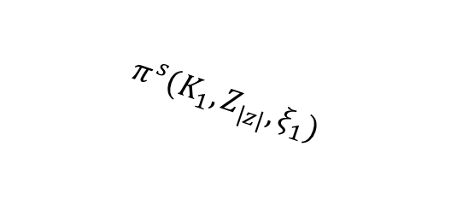

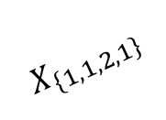

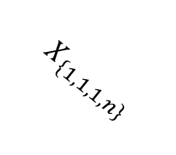




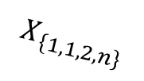
MILP(OBJECTIVE FUNCTION)
max $E\left[π^{s}\right]= ∑_{_\left\{i=1\right\} }^{I}$ $p_{(ξ_{i})}$ $∑_{_\left\{j=1\right\} }^{J}$ $∑_{_\left\{l=1\right\} }^{l}$ $π^{s}(K_{j}, Z_{l}, ξ_{i})$ $∑_{_\left\{m=1\right\} }^{m}X_{\left\{i,j,l,m\right\}}$
Eq.(8)
$$I=\{1,2\}$$
$$π^{s}(K_{1}, Z_{1}, ξ_{1})$$
$$X_{\left\{1,1,1,1\right\}}$$
$$m1$$
$$p_{(ξ_{1})}$$
$$j1$$
$$l1$$
$$π^{s}(K_{1}, Z_{2}, ξ_{1})$$
$$i1$$
$$X_{\left\{1,1,2,1\right\}}$$
$$j2$$
…
$$π^{s}(K_{1}, Z_{|z|}, ξ_{1})$$
$$l2$$
$$X_{\left\{1,1,1,n\right\}}$$
$$p_{(ξ_{2})}$$
…
…
$$X_{\left\{1,1,2,n\right\}}$$
$$M$$
$$i2$$
$$|K|$$
$$|Z|$$

Slide 21
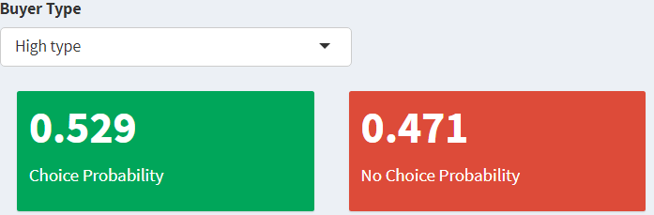
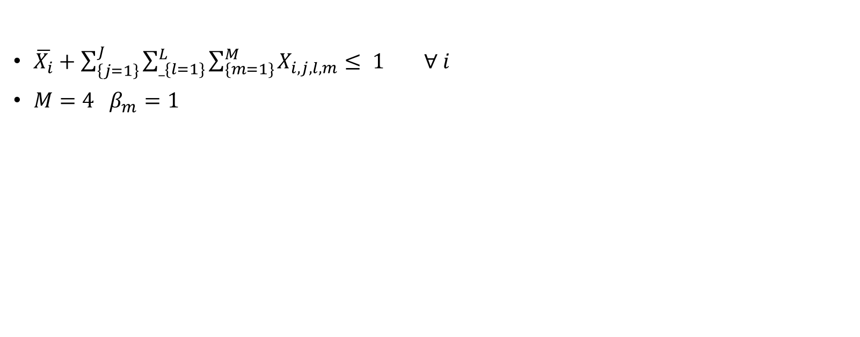
MILP (Probabilities)
$\overline{X_{i}}+\sum_{\left\{j=1\right\}}^{J}{\sum_{_\{l=1\}}^{L}{\sum_{\{m=1\}}^{M}{X_{i,j,l,m}}}}≤ 1 ∀ i$
$M=4 β_{m}=1$
(9) Choice probability and Opt-out probability.

Slide 22

MILP (CONTRACT RATIO CONSTRAINT)
$X_{i,j,l,m}≤\frac{a_{ij,l,m}}{\overline{a_{i}}} \overline{X_{i}} ∀i,j,l,m$ (11)
Ensures that ratio of contract probability are obeyed
$a_{ij,l,m}=e^{v_{i,j,l,m}}$
$\overline{a_{i}}=e^{\overline{v_{i}}}$
therefore $Ratio_{i,j,l,m} = \frac{a_{i,j,l,m}}{\overline{a_{i}}}=\frac{e^{v_{i,j,l,m}}}{e^{\overline{v_{i}}}}$.
This exploits the IIA(Independence from irrelevant Alternative) property

Slide 23
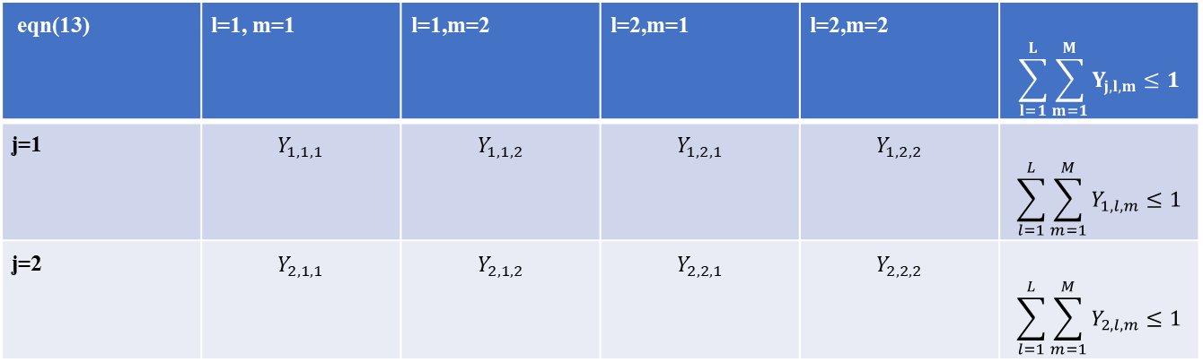
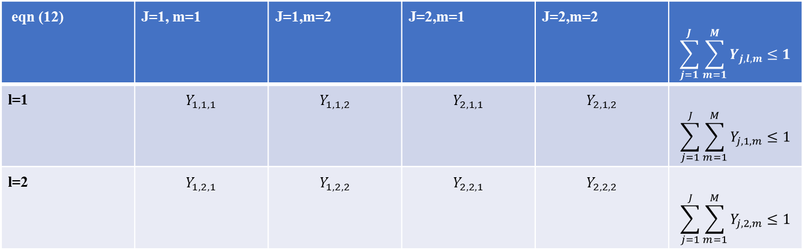
MILP (CONTRACT ESTABLISHMENT CONTRAINTS)
eqn (12) | J=1, m=1 | J=1,m=2 | J=2,m=1 | J=2,m=2 | $$\sum_{j=1}^{J}{\sum_{m=1}^{M}{Y_{j,l,m}}≤1}$$
l=1 | $$Y_{1,1,1}$$ | $$Y_{1,1,2}$$ | $$Y_{2,1,1}$$ | $$Y_{2,1,2}$$ | $$\sum_{j=1}^{J}{\sum_{m=1}^{M}{Y_{j,1,m}}≤1}$$
l=2 | $$Y_{1,2,1}$$ | $$Y_{1,2,2}$$ | $$Y_{2,2,1}$$ | $$Y_{2,2,2}$$ | $$\sum_{j=1}^{J}{\sum_{m=1}^{M}{Y_{j,2,m}}≤1}$$
Equation (12) and (13) Ensures that a contract is exactly in one cardinality or not at all
eqn(13) | l=1, m=1 | l=1,m=2 | l=2,m=1 | l=2,m=2 | $$\sum_{l=1}^{L}{\sum_{m=1}^{M}{Y_{j,l,m}}≤1}$$
j=1 | $$Y_{1,1,1}$$ | $$Y_{1,1,2}$$ | $$Y_{1,2,1}$$ | $$Y_{1,2,2}$$ | $$\sum_{l=1}^{L}{\sum_{m=1}^{M}{Y_{1,l,m}}≤1}$$
j=2 | $$Y_{2,1,1}$$ | $$Y_{2,1,2}$$ | $$Y_{2,2,1}$$ | $$Y_{2,2,2}$$ | $$\sum_{l=1}^{L}{\sum_{m=1}^{M}{Y_{2,l,m}}≤1}$$

Slide 24

MILP (MAXIMUM CONTRACT CONSTRAINTS)
$\sum_{j=1}^{J}{ \sum_{l=1}^{L}{\sum_{m=1}^{M}{Y_{j,l,m }=C ∀j}}}$
$\sum_{m=1}^{M}{m⋅Y_{j,l,m}}=C ∀j,l$
Ensures that not more than number of contracts C are established.
Equations (14) and (15)

Slide 25
RESULTS
Model Comparison
Contracts Offered
Expected Supplier Profit
Probability
Supply Chain Profit
Current vs Previous Model

Slide 26
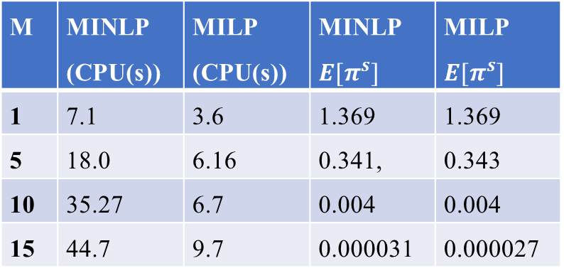

RESULTS (MODEL COMPARISON)
When both MINLP and MILP are tested, it yields approximately same results, with MILP faster than MINLP.
Increase in Choice set Size M, results in more delayed time in computation.
$β_{π^{b}}=1$ and $β_{π^{b}}=1$
M | MINLP (CPU(s)) | MILP (CPU(s)) | MINLP $E[π^{s}]$ | MILP $E[π^{s}]$
1 | 7.1 | 3.6 | 1.369 | 1.369
5 | 18.0 | 6.16 | 0.341, | 0.343
10 | 35.27 | 6.7 | 0.004 | 0.004
15 | 44.7 | 9.7 | 0.000031 | 0.000027

Slide 27
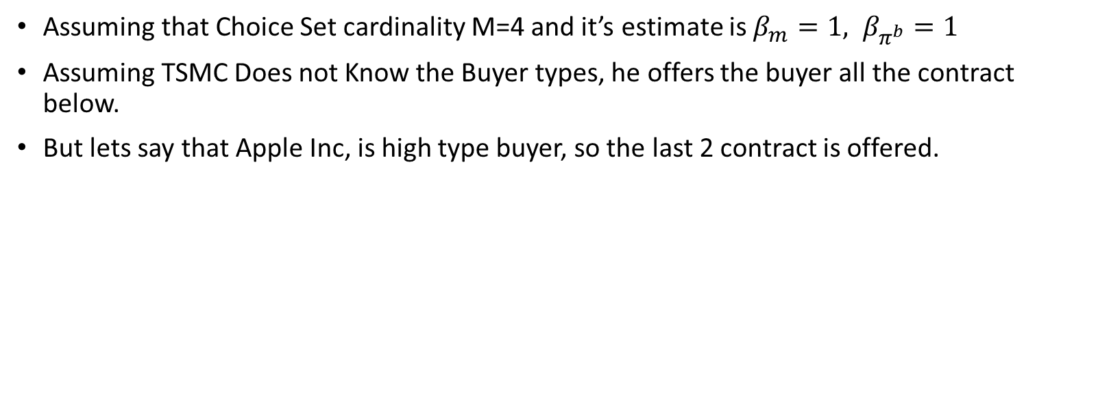
RESULTS (CONTRACTS OFFERED)
Assuming that Choice Set cardinality M=4 and it’s estimate is $β_{m}=1, β_{π^{b}}=1$
Assuming TSMC Does not Know the Buyer types, he offers the buyer all the contract below.
But lets say that Apple Inc, is high type buyer, so the last 2 contract is offered.
K_{j} | Z_{l} | Buyer Profit(ξ = − 1) | Buyer Profit(ξ = 1) | Supplier Profit(ξ = − 1) | Supplier Profit(ξ = 1)
1 | 1.5 | -0.375 | 0.000 | 1.75 | 2.00
2 | 1 | 0.500 | 2.000 | 1.00 | 2.00
3 | 0.75 | 0.750 | 3.375 | 0.25 | 2.00
4 | 1.25 | 0.250 | 3.250 | 0.25 | 2.25

Slide 28

RESULT ( EXPECTED SUPPLIER PROFIT)
The inclusion of Choice set size $M$ as an attribute, reduces the choice probability of buyer $X_{i,j,l}$ , this effects the $E\left[π^{s}\right]$ as seen in equation (1).

Slide 29
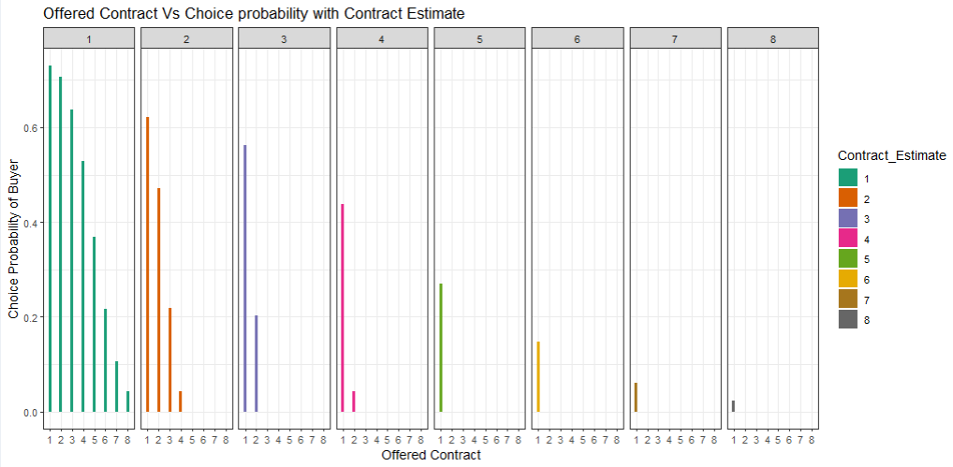

RESULT (PROBABILITY)
Thus, Higher the offered Contract M, lowers $X_{i,j,l}$ .

Slide 30

RESULT (SUPPLY CHAIN PROFIT)
Due to this effect, the mathematical model (MINLP or MILP) tries to maximize $E\left[π^{s}\right]$ by selecting contracts $(K,Z)$ with higher buyers’ profit $π^{b}\left(K_{j},Z_{l},ξ_{i}\right)$ to increase $X_{i,j,l}$ at the same time maximizing $E\left[π^{s}\right]$.
As the supply chain profit $E\left[π^{sc}\right]=E\left[π^{b}\right]\text{+} E\left[π^{s}\right]$ remains constant, TSMC will show a more balanced contract to Apple Inc.

Slide 31
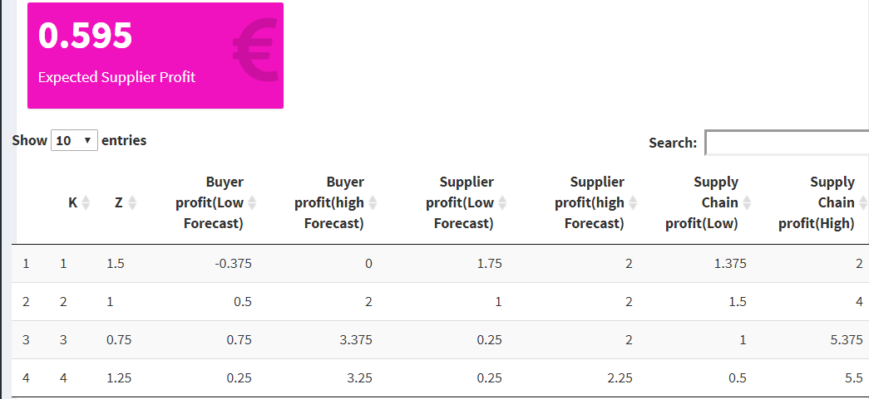
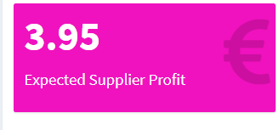
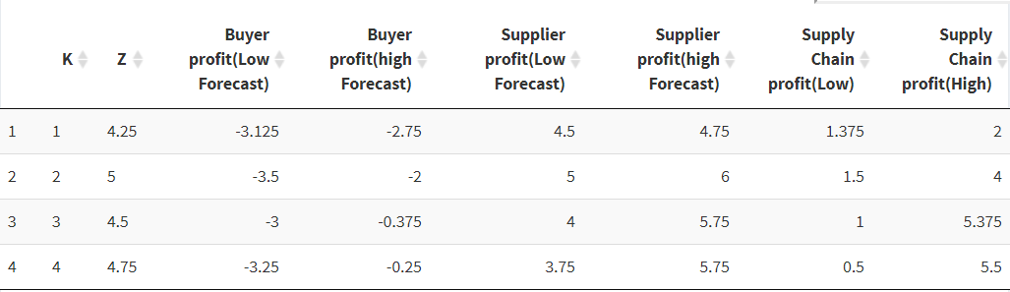


RESULT (Current vs Previous model )
$$v_{i,j,l}=β_{π^{b}}⋅π^{b}\left(K_{j},Z_{l},ξ_{i}\right)−β_{m}M$$
$$v_{i,j,l}=β_{π^{b}}⋅π^{b}\left(K_{j},Z_{l},ξ_{i}\right)$$

Slide 32
DEMO
Contract Menu generation in R Shiny.
And Results in R shiny.
https://diegouchendu.shinyapps.io/contract_selection_app/

Slide 33
CONCLUSION
Buyers‘ choice overload can be reduced by this model if buyers‘ choice set size effect is captured.
it is also worth finding how other attributes of a contracts and characteristics of a buyer affects the buyer’s choice probability.

Slide 34

THANKS YOU

Slide 35
REFERENCES
BASOV, S. (2009). Monopolistic Screening with Boundedly Rational Consumers. Economic Record, 85, S29–S34.
Haase K, Müller S (2014) A comparison of linear reformulations for multinomial logit choice probabilities in facility location models. Eur J Oper Res 232(3):689–691
Haynes GA. (2009) Testing the boundaries of the choice overload phenomenon: The effect of number of options and time pressure on decision difficulty and satisfaction. Psychology & Marketing, 26(3):204-12.
Jeet. (2021). Apple to account for 53% of TSMC 5nm chips production in 2021. Available: https://www.gizmochina.com/2021/02/08/apple-tsmc-5nm-chips-2021/. Last accessed 10th April 2021.
Koppelman F.S., Bhat C.R (2006) A self instructing course in mode choice modeling: multinomial and nested logit models. Prepared for U.S. Department of Transportation Federal Transit Administration.
Krohn, R., Müller, S., & Haase, K. (2020). Preventive healthcare facility location planning with quality-conscious clients. OR Spectrum
Özalp Özer, Wei Wei, (2006) Strategic Commitments for an Optimal Capacity Decision Under Asymmetric Forecast Information. Management Science 52(8):1238-1257
Römer, N., Voigt, G., Müller, S.(2020). A Choice-Based Optimization Approach for Contracting in Supply Chains. Working Paper.

Slide 36
Explaining Equation 5 slide 14

Slide 37
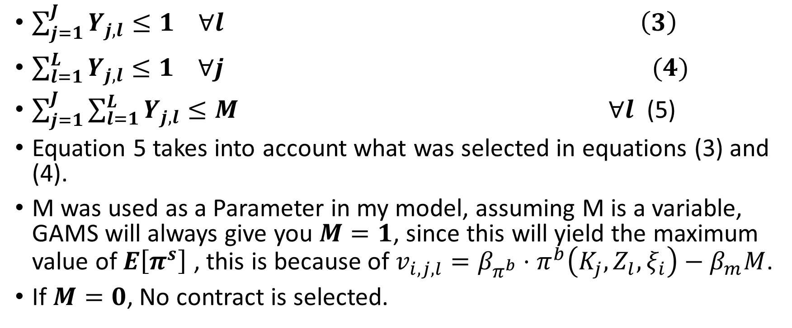
$\sum_{j=1}^{J}{Y_{j,l}}≤1 ∀l \left(3\right)$
$\sum_{l=1}^{L}{Y_{j,l}}≤1 ∀j (4)$
$\sum_{j=1}^{J}{\sum_{l=1}^{L}{Y_{j,l}}}≤M ∀l$ (5)
Equation 5 takes into account what was selected in equations (3) and (4).
M was used as a Parameter in my model, assuming M is a variable, GAMS will always give you $M=1$, since this will yield the maximum value of $E\left[π^{s}\right]$ , this is because of $v_{i,j,l}=β_{π^{b}}⋅π^{b}\left(K_{j},Z_{l},ξ_{i}\right)−β_{m}M$.
If $M=0$, No contract is selected.

Slide 38
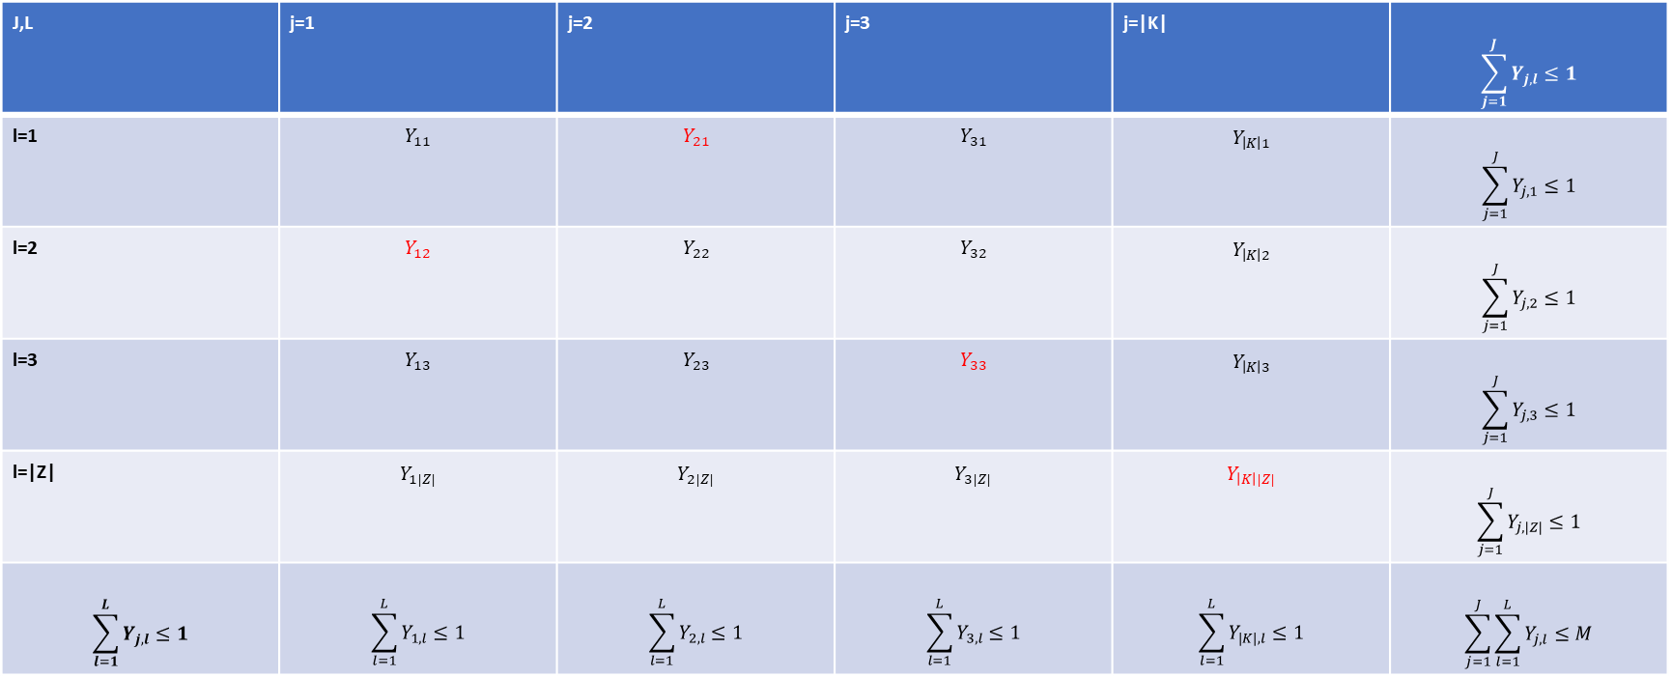
Equation 14 Table (Selected Contracts in Red)
J,L | j=1 | j=2 | j=3 | j=|K| | $$\sum_{j=1}^{J}{Y_{j,l}}≤1$$
l=1 | $$Y_{11}$$ | $$Y_{21}$$ | $$Y_{31}$$ | $$Y_{\left|K\right|1}$$ | $$\sum_{j=1}^{J}{Y_{j,1}}≤1$$
l=2 | $$Y_{12}$$ | $$Y_{22}$$ | $$Y_{32}$$ | $$Y_{\left|K\right|2}$$ | $$\sum_{j=1}^{J}{Y_{j,2}}≤1$$
l=3 | $$Y_{13}$$ | $$Y_{23}$$ | $$Y_{33}$$ | $$Y_{\left|K\right|3}$$ | $$\sum_{j=1}^{J}{Y_{j,3}}≤1$$
l=|Z| | $$Y_{1|Z|}$$ | $$Y_{2|Z|}$$ | $$Y_{3|Z|}$$ | $$Y_{\left|K\right||Z|}$$ | $$\sum_{j=1}^{J}{Y_{j,|Z|}}≤1$$
$$\sum_{l=1}^{L}{Y_{j,l}}≤1$$ | $$\sum_{l=1}^{L}{Y_{1,l}}≤1$$ | $$\sum_{l=1}^{L}{Y_{2,l}}≤1$$ | $$\sum_{l=1}^{L}{Y_{3,l}}≤1$$ | $$\sum_{l=1}^{L}{Y_{|K|,l}}≤1$$ | $$\sum_{j=1}^{J}{\sum_{l=1}^{L}{Y_{j,l}}≤M}$$

Slide 39

Assuming $y_{\left\{1,2\right\}},y_{\left\{21\right\}},y_{\left\{3,3\right\}}, y_{\left\{\left|K\right|,\left|Z\right|\right\}}$ where selected.
$y_{\left\{1,2\right\}}+y_{\left\{21\right\}}+y_{\left\{3,3\right\}}+y_{\left\{\left|K\right|,\left|Z\right|\right\}}=4$
This is equivalent to choosing contracts {(0, 0.25), (1,0), (2,0.5), (5,21)} using the step side explained in slide 9.

